Slide 1
Cogs 10 Final Project:
Analyzing Breakdowns
Zuckerberg’s a Robot: Confirmed
Aimee Lee
Emily Pettitt
Louis Morales
Mia Schloss
Rashad Anderson

Slide 2
Overview
What are breakdowns?
When something doesn’t work the way the designer or the user intended it to
Can occur in electronic and non-electronic devices
May have work-arounds available
Viscosity
Research Questions:
What kind of breakdowns are most likely to occur?
Was there a correlation between how impactful the breakdown was and if there was an available work-around?
Where were breakdowns more likely to occur?
Notes:
-what are breakdowns
Breakdowns are an example of viscosity in a device, or
-methods used
-research questions

Slide 3
Methods
Analyzed the variety of data on breakdowns our group had collected in Project 3, focusing on specific research questions/categories of interest.
Used the data from the spreadsheet to create visualizations (maps, pie charts, bar graphs) to analyze the data in alternative ways and effectively communicate it to our peers.
Analyzed the data according to the data presented in the visualization form, the total data recorded about the breakdowns, and general knowledge of students’ lives.
Notes:
Data was collected on a self-reported basis by a group of 10 individuals
We used different visualization forms for our data, as presenting data in different forms may enable us to see new patterns/relationships we would not have been able to establish if we were to use another visualization form instead

Slide 4
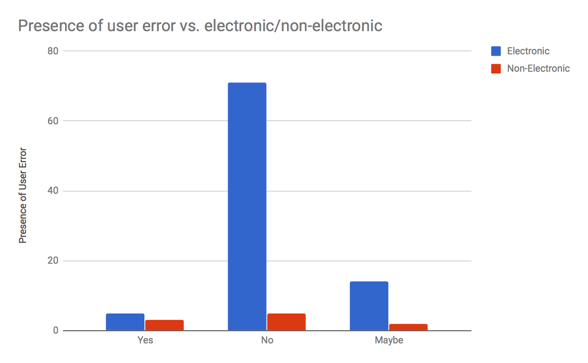
Electronic vs Non-Electronic and User Error
The majority of breakdowns are electronic, as opposed to non-electronic
User error is rarely credited as reason for electronic breakdowns, as opposed to the relatively even distribution for non-electronic breakdowns
Notes:
Because students use electronic devices more frequently?
Students subject devices to a lot of wear and tear (frequently drop phones)
Because students are more confident about their ability to use electronics?
Possibly students may not realize they are using their devices incorrectly?

Slide 5
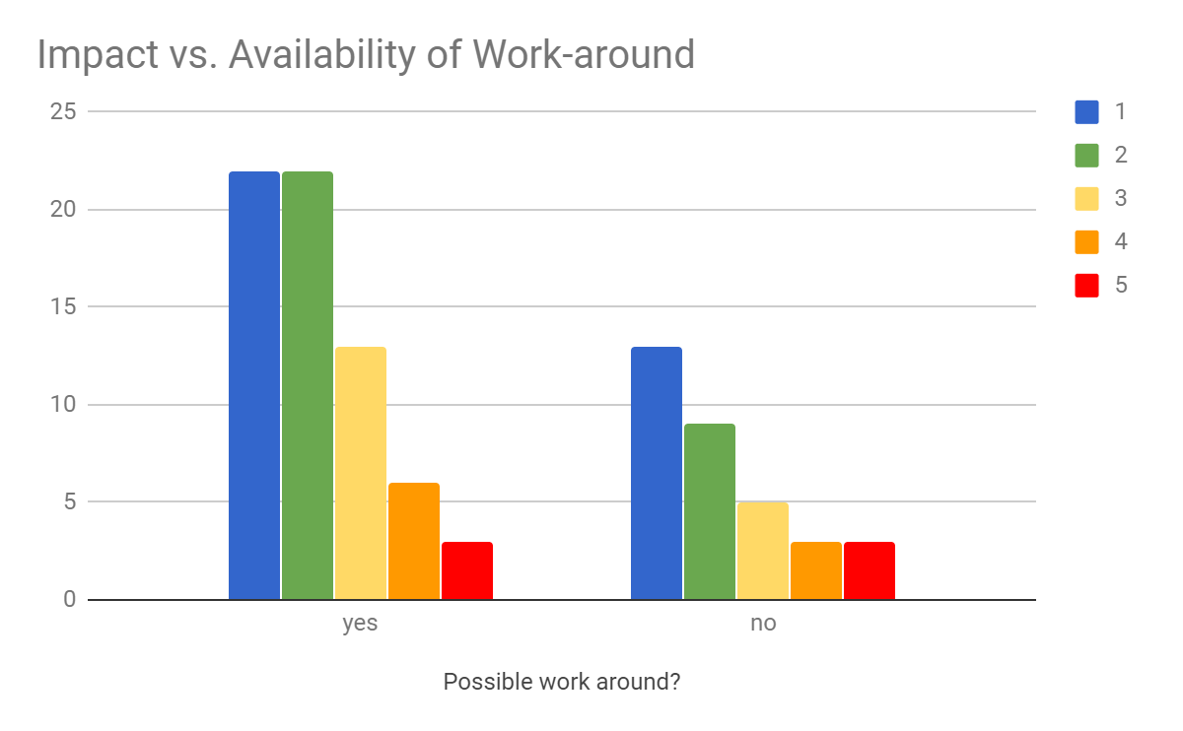
Impactfulness and Work-Around Availability
Twice as many subjects found work-arounds than those who didn’t
(66 did, 33 did not)
Work-arounds were found more frequently for less-impactful breakdowns (levels 1, 2)
The average impact with available work-around (3) vs average impact with no work-around (2)
However, there were fewer work-arounds for the most impactful breakdowns (levels 4, 5)
Notes:
This shows people adapt well to difficulties to find temporary or permanent solutions to breakdowns (bring up Thoughtless Acts mentioned in class?)
people have greater need for work-arounds when the breakdown would impact them more
But if impact is too big, may be the type of breakdown the subject can’t fix themselves

Slide 6
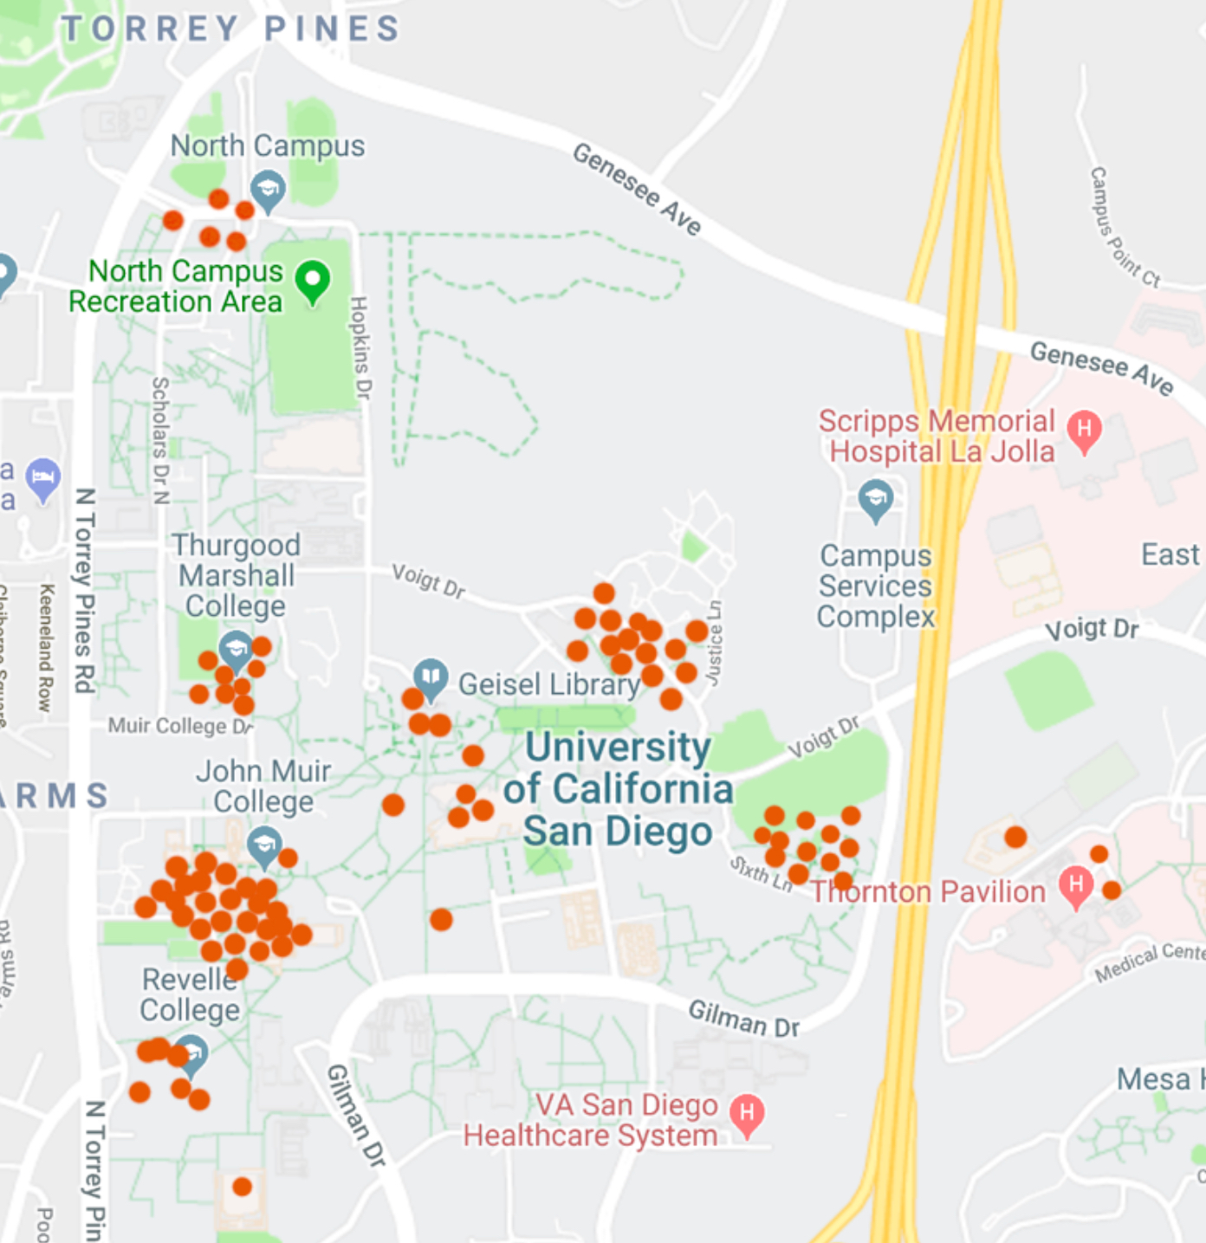
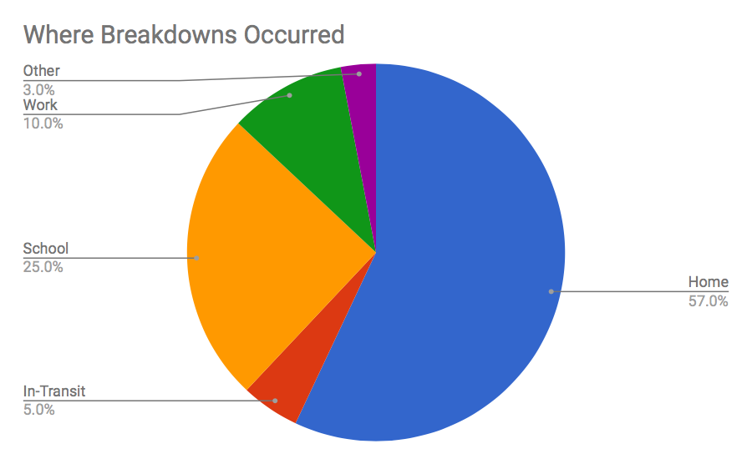
Where Breakdowns Occur
The majority of breakdowns occured in the subject’s place of residence
Either on or off campus
The second was at school
lecture halls, study rooms, etc.
Noted clustering around places of residence and study
Notes:
This is likely due to amount students utilize electronics in their studies--prompting breakdowns to occur more frequently in these areas
However useful this map may be, it is very difficult to know EXACTLY where a breakdown occurred, and as such the dots are simply approximations of where they truly occurred

Slide 7
SUMMARY
Breakdowns are when cognitive artifacts stop working fluidly, and disrupt our processes
The majority of recorded breakdowns are electronic
When a work-around is present, subjects tended to report the breakdown as less impactful
Breakdowns frequently occured around areas of residence

